Slide 1
SELECTIVE-REPEAT AUTOMATIC REPEAT REQUEST
Name – Ananya Ghosal Stream – CSE Year – 3rd Semester – 6th
Roll No. – 16800117060 Subject – Computer Network Assignment

Slide 2
Selective-Repeat ARQ
Go-Back-N ARQ inefficient because multiple frames are resent when errors or losses occur.
Selective Repeat retransmits only an individual frame > Timeout causes individual corresponding frame to be resent > NAK causes retransmission of oldest un-acked frame.
Receiver maintains a receive window of sequence numbers that can be accepted > Error-Free, but out-of-sequence frames with sequence numbers within the receive window are buffered.
> Arrival of frame with R_{next} causes window to slide forward by 1 or more.

Slide 3
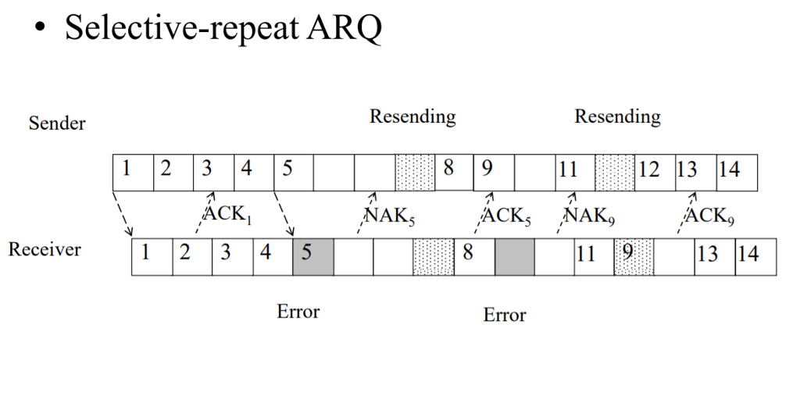

Slide 4
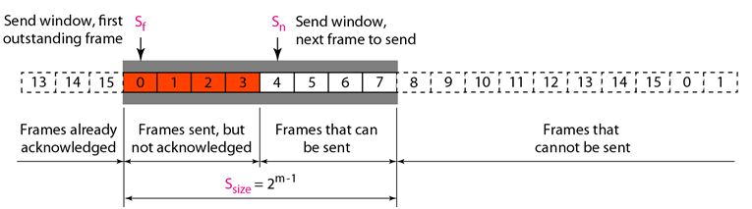
The Selective Repeat Protocol also uses two windows: a send window and a receive window. However, there are differences between the windows in this protocol and the ones in Go-Back-N. First, the size of the send window is much smaller; it is 2^{m}- 1.
The send window maximum size can be 2^{m}- 1. The smaller window size means less efficiency in filling the pipe, but the fact that there are fewer duplicate frames can compensate for this.
The Selective Repeat Protocol allows as many frames as the size of the receive window to arrive out of order and be kept until there is a set of in-order frames to be delivered to the network layer. Because the sizes of the send window and receive window are the same, all the frames in the send frame can arrive out of order and be stored until they can be delivered. We need, however, to mention that the receiver never delivers packets out of order to the network layer.

Slide 5
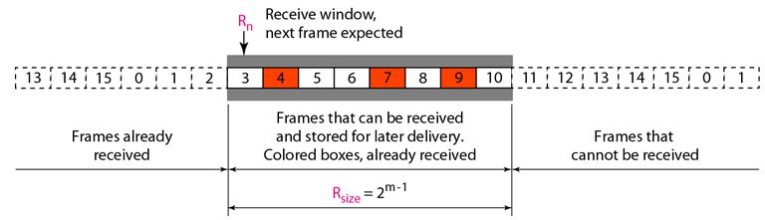
The above figure shows the receive window in this protocol. Those slots inside the window that are colored define frames that have arrived out of order and are waiting for their neighbors to arrive before delivery to the network layer.

Slide 6
Window Sizes:
We can now show why the size of the sender and receiver windows must be at most one half of 2m. For an example, we choose m = 2, which means the size of the window is 2^{m}/2, or 2. The following figure compares a window size of 2 with a window size of 3.
If the size of the window is 2 and all acknowledgments are lost, the timer for frame 0 expires and frame 0 is resent. However, the window of the receiver is now expecting frame 2, not frame 0, so this duplicate frame is correctly discarded.
When the size of the window is 3 and all acknowledgments are lost, the sender sends a duplicate of frame 0. However, this time, the window of the receiver expects to receive frame 0 (0 is part of the window), so it accepts frame 0, not as a duplicate, but as the first frame in the next cycle. This is clearly an error.

Slide 7
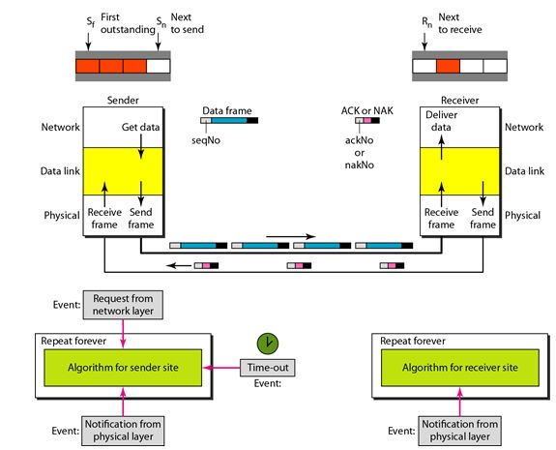
Selective-Repeat ARQ Design

Slide 8
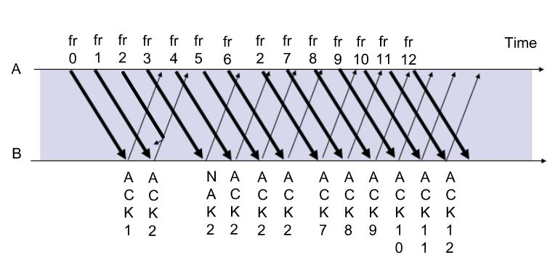
Selective-Repeat ARQ

Slide 9
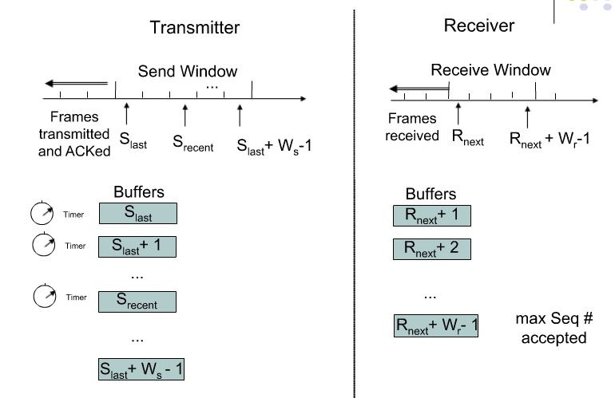

Slide 10
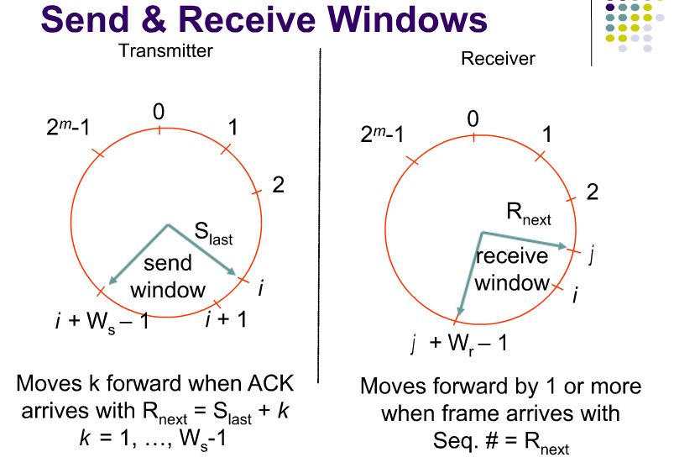
Send And Receive Windows

Slide 11
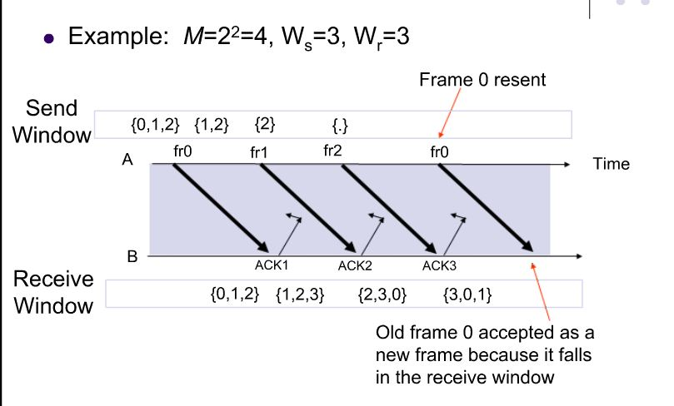
What Size Ws and Wr allowed?

Slide 12
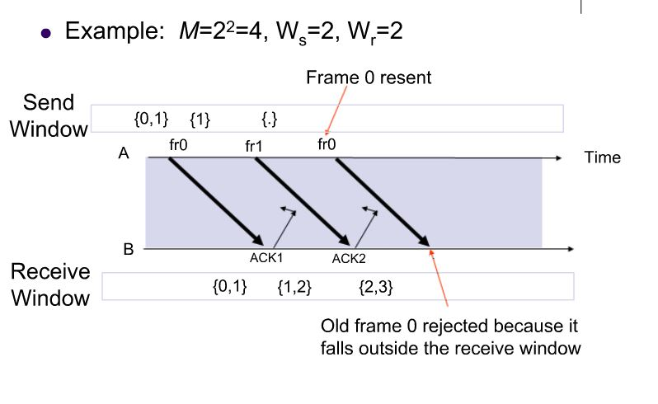
Ws + Wr = 2^{m} is maximum allowed

Slide 13
Application of Selective Repeat ARQ
TCP (Transmission Control Protocol): transport layer protocol uses variation of selective repeat to provide reliable stream service.
Service Specific Connection Oriented Protocol: error control for signalling messages in ATM networks

Slide 14
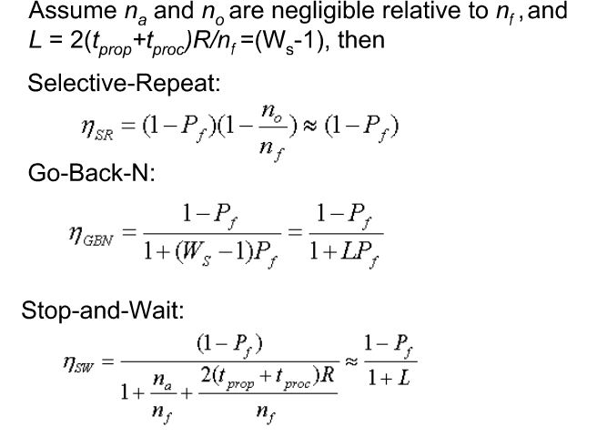
Comparision of ARQ efficiencies:

Slide 15
Thank You
Name – Ananya Ghosal Stream – CSE Year – 3rd Semester – 6th
Roll No. – 16800117060 Subject – Computer Network Assignment

